Slide 1
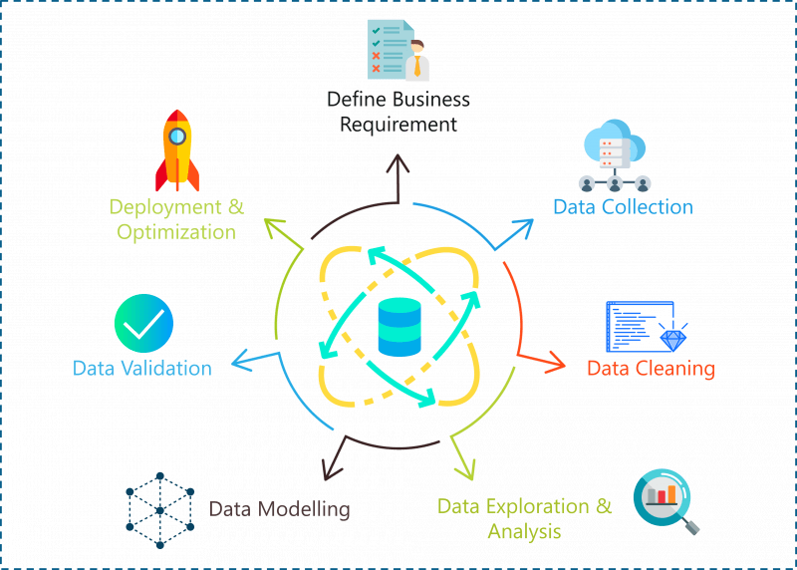
Data Science Project
Karthik Venkatachalam
Data Science – Subject Matter Expert

Slide 2

Data Science Project Life Cycle
Business Understanding
Data Collection
Data Cleaning
Data Analysis
Feature Engineering
Model Building
Deployment

Slide 3
Business Understanding in Data Science
What is Business Understanding?
Involves defining business problems, objectives, and requirements.
Key Steps:
Define Objectives
Identify Key Variables
Define Success Metrics
Identify Data Sources

Slide 4
Data Collection & Cleaning
Data Collection:
Gather data from various sources.
Data is typically raw.
Data Cleaning:
Identify and fix errors.
Vital for accuracy and analysis.
Steps:
Remove duplicates
Eliminate irrelevant data
Standardize
Ensure data consistency
Handle outliers
Correct errors
Manage missing values

Slide 5

Exploratory Data Analysis (EDA)
EDA Purpose:
Understand data and extract insights.
Identify data characteristics.
Techniques:
Analyze data distribution.
Handle missing values, outliers, duplicates.
Encode variables.
Normalize and scale.
Tools:
Use Python libraries (NumPy, Pandas, Matplotlib, Seaborn).
Importance:
Informs data understanding and hypothesis generation.
Guides model and technique selection.

Slide 6
Feature Engineering
Purpose
Improve machine learning model performance.
Create or modify features using domain knowledge.
Techniques
Imputation, handling outliers, binning, log transform, one-hot encoding, grouping operations, feature split, scaling, date extraction.
Importance
Crucial in machine learning, data mining, and data analytics.
Correct features enhance predictive models.
Tools
Python libraries (Pandas, NumPy, Scikit-learn) are commonly used.

Slide 7
Model Building and Deployment
Model Building
Select algorithm.
Train using engineered features.
Validate performance.
Model Evaluation
Assess against objectives.
Use metrics like accuracy.
Model Deployment
Deploy in preferred structure.
Provides predictions.
Varied deployment forms.
Model Monitoring
Continuous performance monitoring.
Address drift or decline.

Slide 8
Applications of Data Science in real-world
E-commerce: Recommender systems for product recommendations, sales forecasting, and customer churn prediction.
Manufacturing: Predictive maintenance, quality control, and supply chain optimization.
Education: Personalized learning pathways, student performance prediction, and enrollment management.
Transportation and Logistics: Route optimization, demand forecasting, and vehicle tracking.
Energy: Predictive maintenance for equipment, energy consumption optimization, and grid management.
Environmental Science: Climate modeling, natural disaster prediction, and conservation efforts

